Slide 1

LGE Internal Use Only
Analysis / Design Template Usage Guide
VSW Process Unit
LG Electronics Inc.

Slide 2
Document Info
Document Information
Issuing authority | SW Architect Unit
Status of document | In Progress / Approved / Released
Revision History
Version | Date | Comment | Author | Approver
1.0 | 2019-03-29 | Initial version | GuanRok Park | SW Architect Team Leader

Slide 3
Contents
Overview
Composition of Analysis/Design Documentation
Separation of SyRS
Separation of SRS
Separation of HLD
Integration of SDD
Example of Documentation Composition by SW Structure type
SW Structure Type A-CSD Example
SW Structure Type B-HUD Example
SW Structure Type C-ADAS Example
SW Structure Type D-AVN Example
SW Structure Type E-Telematics Example
APPENDIX 1. EA and Automatic creation of documentation
APPENDIX 2. Traceability Module Setup (Doors)

Slide 4
1. Overview
Purpose | This document is a guide to help you adjust/use the analysis/design template in a project according to the project type or SW structure. This document provides examples for five representative SW types. Analysis/design template adjustment is led by the project SW architect and decided by consensus within the development team.
Scope | Projects applying the VS Standard Template SysRS v2.0, SysAD v2.0, SRS v3.0, SAD(Type2), SDD(Type2)
Glossary
Term | Definition | Term | Definition
CRS | Customer Requirements Specification | CSD | Center Stack Display
SysRS | System Requirements Specification | HUD | Head Up Display
SRS | Software Requirements Specification | AVN | Audio Video Navigation
SysAD | System Architecture Design | ADAS | Advanced Driver Assistant System
SAD | Software Architecture Design | HLD | High Level Design (Interface design between components)
SDD | Software Detailed Design | UC | Use Case
UML | Unified Modeling Language | SD | Sequence Diagram
EA | Enterprise Architect (UML tool) | SW | Software
Class structure SW : SW is a set of classes
Component structure SW : SW is a set of components
Feature : Set of functions
Component : Set of classes. SAD describes components. SDD is written for each component.
Class : Set of attributes and operations
References
[1] LGE, VS SysRS template, v2.0
[2] LGE, VS SysAD template, v2.0
[3] LGE, VS SRS template, v3.0
[4] LGE, VS SAD template(type 2), v1.0
[5] LGE, VS SDD template(type 2), v1.0

Slide 5
2. Composition of Analysis/Design Documentation
Class structure SW: Relationship between SAD(structure)-SDD(dynamic design/Unit design),
Component structure SW: Relationship between SAD(structure)-HLD-SDD(dynamic design/Unit design)
- HLD defines interface(sequence) between components and is included in SAD or separated.
Class structure (Basic composition)
Component structure (HLD is written separately from SAD)
OEM Req.
CRS
(Stakeholder Req.)
OEM Req.
CRS
(Stakeholder Req.)
SysRS
SysRS
SysAD
SysAD
SRS
SRS
SAD
SAD
SDD
HLD**
Legend
External document
SDD
LGE internal document
Traceability
* Note: If the organization/person in charge/creation time/content is different or dependent, it is recommended to separate the documents at a level that can be assigned to WBS. (Individual documents at the same level can be merged into one for management after approval) ** HLD (High Level Design): A document written by separating Interaction/Interface between components among SAD contents.

Slide 6
3. Separation of SyRS
SysRS can be written for each system / subsystem*, part**, and feature.*** - In case of making a separate document, organize chapters/sections in the following structure
Basic SyRS
(level of system / sub system**)
Separated SysRS
(for each Feature)
Adjustment
Introduction
General System Description
Physical Requirements
3.1 HW
3.2 ME …
4. Functional Req.
4.1 Feature#1
4.1.1 Function or UC#1
4.1.2 Function or UC#n
4.2 Feature#n
5. Quality Attribute
6. Design Constraints
7. System Interface Req.
8. Functional Safety Req.
Introduction
General System Description
Physical Requirements
3.1 HW
3.2 ME …
4. Functional Req.
4.1 Feature#1
4.1.1 Function or UC#1
4.1.2 Function or UC#n
4.2 Feature#n
5. Quality Attribute
6. Design Constraints
7. System Interface Req.
8. Functional Safety Req.
It can be written by part, such as HW, SW, but the entire chapter/section number must be complied with and reflected in the document title so that the overall structure can be understood.
* Subsystem refers to a physically separated system within the project scope. (e.g, Measurement System in ADAS)
** Part: HW, SW, ME, …
*** Since SysRS/SRS does not generally assume design, it is not written for each element/component identified through design.

Slide 7
4. Separation of SRS
SRS is written at the system level, for each feature, or for each subsystem.*
- In case of making a separate document, organize chapters/sections in the following structure.
Basic SRS
(level of system / sub system**)
Separated SRS (for each Feature)
Introduction
Overview
External Interface req.
3.1 SW Context
3.2 External Interfaces
4. Functional Req.
4.1 Feature#1
4.1.1 Function or UC#1
4.1.2 Function or UC#n
4.2 Feature#n
5. Quality Attribute
6. Design Constraints
Introduction
Overview
External Interface req.
3.1 Feature Context
3.2 External Interfaces
4. Functional Req.
4.1 Feature#1
4.1 Function or UC#1
4.2 Function or UC#n
4.2 Feature#n
5. Quality Attribute
6. Design Constraints
Adjustment
* Since SysRS/SRS does not generally assume design, it is not written for each element/component identified through design.
** Subsystem refers to a physically separated system within the project scope. (e.g, Measurement System in ADAS, Audio Subsystem)

Slide 8
5. Separation of HLD
HLD is basically written for each feature, and when it is separated from SAD and created as a separate document, chapters/sections are adjusted as follows including Feature/Subsystem context.
Basic SAD
Separated HLD
Introduction
Architectural Drivers
SW Context
SW Architecture
Resource Consumption
Interaction Design
6.1 Feature#1
7. Interface Design
7.1 Feature#1
8. QA Scenario / Alternatives
9. Future Extension
Introduction
Feature/Function list (Scenario or UC)
3. Feature/Subsystem Context
4. Interaction Design
4.1 Feature#1
4.1.1 SD for Scenario#1 or UC#1
…
5. Interface Design
5.1 Feature#1
5.1.1 Interfaces for Scenario#1 or UC#1
…
Adjustment

Slide 9
6. Integration of SDD
SDD is basically written for one component. When composing documents for each subsystem or feature, including the subsystem/feature context, adjust chapters/sections as follows. When HLD is integrated by subsystem or feature, it is located as a separate chapter.
Basic SDD
N SDDs integrated
N SDDs integrated (HLD is integrated)
Adjust-ment
Introduction
Component Context*
Static Design
Dynamic Design
Algorithm Design
Global Variables
Design Alternatives**
1. Introduction
1.2 Scope :Includes Feature context
2. Component#1
2.1Component Context
2.2 Static Design
2.3 Dynamic Design
2.4 Algorithm Design
2.5 Global Variables
3. Compoenent#2
3.1 Component Context*
3.2 Static Design
3.3 Dynamic Design
3.4 Algorithm Design
3.5 Global Variables
…
n. Design Alternatives
1. Introduction
1.2 Scope: Includes Feature context
3. Inter Component Interaction
3. Component#1
3.1Component Context
3.2 Static Design
3.3 Dynamic Design
3.4 Algorithm Design
3.5 Global Variables
4. Compoenent#2
4.1 Component Context*
4.2 Static Design
4.3 Dynamic Design
4.4 Algorithm Design
4.5 Global Variables
…
n. Design Alternatives
* Includes external Interface
** Design Alternatives for SDD is added in ASPICE 3.0.

Slide 10
7. Example of Documentation Composition by SW Structure type
Five types of SW structure developed in VS are presented, and examples of each document structure are provided in subsections.
- The document organization examples presented in this document are reference materials for document organization, and do not limit the document organization.
- Document organization can change chapters/sections to systematically organize content.
 |  | Number of Documents
SW Type | CPU | SysRS | SysAD | SRS | SAD | HLD | SDD
A - CSD | 1 | 3 | 1 | 1 | 1 | - | 1
B - HUD | 2 | 1 | 1 | 1 | 1 | - | 1
C - ADAS | 2 | 3 | 1 | 1 (18 integrations) | 1 | 1 (18 integrations) | 9
D - AVN | 2 | 1 | 1 | 1 (40 integrations) | 1 | 40 | 32
E - Telematics | 3 | 12 | 1 | 10 | 1 | 10 | 32
* The number of documents in the table above is just an example.

Slide 11
7.1 SW Structure Type A: CSD Example
24 Classes in 1 MCU.
- Identify 24 classes in SAD and design dynamic design and algorithm in SDD.
SW Structure
SAD structure (1EA)
Introduction
Architectural Drivers
SW Context
SW Architecture
Resource Consumption
Interaction Design
Interface Design
8. QA Scenario / Alternatives
9. Future Extension
Reuse
Remove
SDD structure (1EA)
Introduction
Component Context -> UC diagram
Static Design
Dynamic Design
Algorithm Design
5.1 PBL
5.2 APP
…
6. Global Variables
7. Design Alternatives
Identify design scope for each iteration

Slide 12
7.2 SW Structure Type B: HUD Example
2 CPU, 2 SW Components,
Identify 10+9 classes in SAD and design dynamic design and algorithm for two components in one SDD.
SW Structure
SAD structure (1EA)
Introduction
Architectural Drivers
SW Context
SW Architecture
Resource Consumption
Interaction Design
Interface Design
8. QA Scenario / Alternatives
9. Future Extension
Reuse
Remove
SDD structure (1EA)
Introduction
Component Context -> UC diagram
Static Design
Dynamic Design
Algorithm Design
5.1 LLD
5.2 CHUD
…
6. Global Variables
7. Design Alternatives
Identify design scope for each iteration

Slide 13
7.3 SW Structure Type C: ADAS Example
2 CPU, Component+Class Type
Identify 24 classes in SAD,
Design Interface between components for each feature in HLD (Creation by feature /Integration management),
Design dynamic behavior and algorithm (SDD for each component other than one MCU)
SAD structure
Introduction
Architectural Drivers
SW Context
SW Architecture
Resource Consumption
Interaction Design
Interface Design
8. QA Scenario / Alternatives
9. Future Extension
Reuse
SW Structure
Separate
HLD structure (1EA)
Introduction
Feature list (Scenario or UC)
3. Component structure
4. Interaction Design
4.1 Feature#1
Feature context#1
4.1.1 SD for Scenario#1 or UC#1
4.2 Feature#n
5. Interface Design
5.1 Feature#1
5.1.1 Interfaces for Scenario#1 or UC#1
…
SDD structure (for each component)
Introduction
Component Context
Static Design
Dynamic Design
Algorithm Design
6. Global Variables
7. Design Alternatives

Slide 14
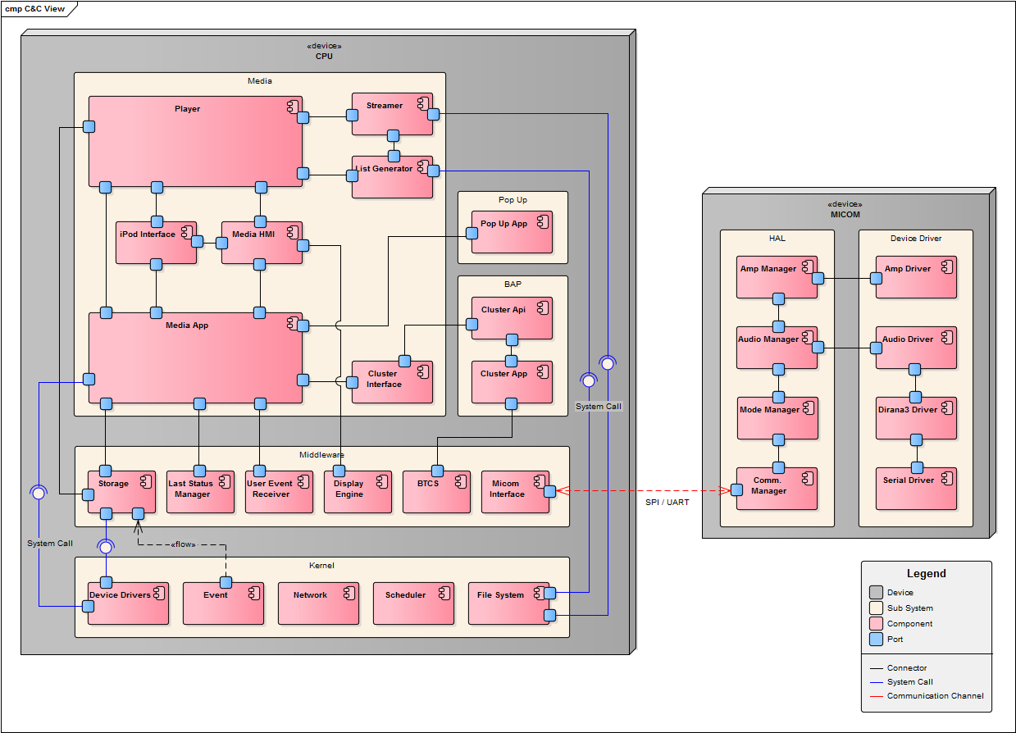
7.4 SW Structure Type D: AVN Example
2 CPU, 393 Use Cases
Identify whole components in SAD. Create HLD for each feature.
Create SDD for each component.
SAD structure (1EA)
Introduction
Architectural Drivers
SW Context
SW Architecture
Resource Consumption
Interaction Design
Interface Design
8. QA Scenario / Alternatives
9. Future Extension
SW Structure
Separate
HLD structure (for each feature)
Introduction
2. Function list
3. Feature Context
4. Interaction Design
4.1 Feature#1
4.1 SD for Scenario#1 or UC#1
…
5. Interface Design
5.1 Feature#1
5.1 Interfaces for Scenario#1 or UC#1
…
SDD structure (for each component)
Introduction
Component Context
Static Design
Dynamic Design
Algorithm Design
6. Global Variables
7. Design Alternatives

Slide 15
7.5 SW Structure Type E: Telematics Example
3 CPU, 10 Features.
Identify components in SAD. Create HLD for each feature.
Create SDD for each component.
SAD structure (1 EA)
Introduction
Architectural Drivers
SW Context
SW Architecture
Resource Consumption
Interaction Design
Interface Design
8. QA Scenario / Alternatives
9. Future Extension
SW Structure
Separate
HLD structure (10EA, for each feature)
Introduction
2. Function list
3. Feature Context
4. Interaction Design
4.1 Feature#1
4.1 SD for Scenario#1 or UC#1
…
5. Interface Design
5.1 Feature#1
5.1 Interfaces for Scenario#1 or UC#1
…
SDD structure (for each component)
Introduction
Component Context
Static Design
Dynamic Design
Algorithm Design
6. Global Variables
7. Design Alternatives

Slide 16
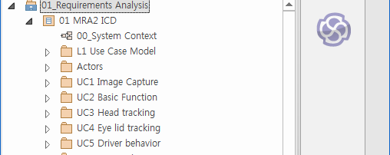
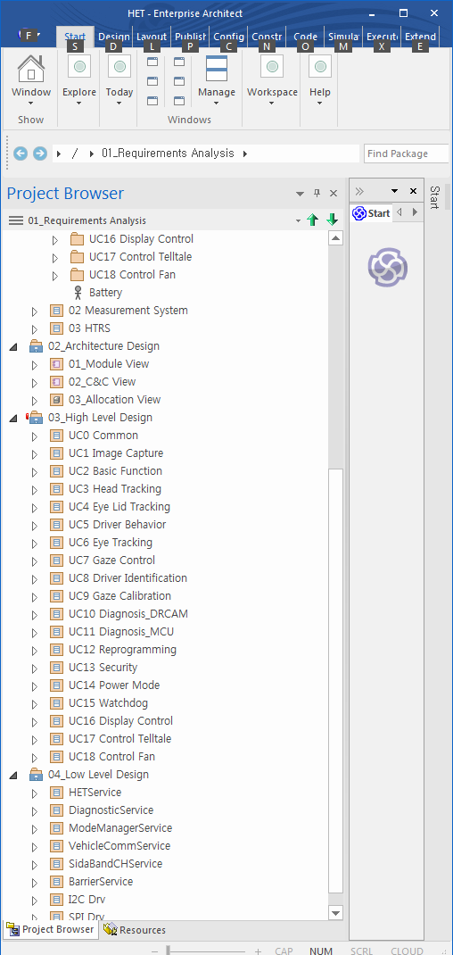
APPENDIX 1. EA and Automatic creation of documentation
When designing using EA, developers focus only on design, regardless of document structure/granularity. The document structure has the advantage that can be freely created according to the WBS or ‘convenience of change management’.
Folder list of EA
Example of Document creation
18 Use case diagrams are used in SRS
3 Views are used in SAD
76 SD of 18 Features are created in 1 HLD
9 Components, 600 functions are created in 9 SDD
* It is recommended to configure the EA folder as a single root for the entire baseline. (The figure is a case in which the root is separated step by step)

Slide 17
APPENDIX 2. Traceability Module Setup (Doors)
If you set up traceability using Doors, you need to properly separate link modules to search for traceability by link.
- Do not set multiple in-links in the same link module in a specific node. (Can be minimized with 4 link modules)
Basic link set
Expanded link set
Traceability link module
In-links coming into a node must be different link modules
CRS
SanityTC
CRS
SanityTC
Link module
Validation
Link_Verification
SysRS
SysTC
SysRS
SysTC
Link_SysAD_SAD
SysAD
HSI
SysITC
SysAD
HSI
SysITC
Link_SWUNIT
Verification
Link_Validation
SRS
SW
TC
SRS
SW
TC
classification/Grouping*
SAD
SAD
SDD
SW
ITC
HLD
SW
ITC
SW
UNIT
UTC
SDD
UTC
Legend
The SysRS-SysAD, SRS-SAD relationship is not at the level of individual requirements and can be grouped as long as the requirements are not omitted (as of ASPICE 3.0) The SAD-SDD relationship is a direct link if there is no individual requirement level content in the SAD. The SAD-SDD relationship only needs to be able to show that all components of the SAD are designed, even without direct linking, unless the SAD has individual requirements level content.
SW
UNIT
Original module
Index
module
TC
module

